Slide 1
THE FORM
Created by Annette Benson, Intercultural Learning Specialist, Purdue CILMAR.
Adapted from Deardorff, D. K. (2012). The form. In K. Berardo & D. K. Deardorff (Eds.), Building cultural competence: Innovative activities and models (pp. 81-85). Stylus Publishing.

Slide 2
SMALL GROUP DEBRIEF
Activity to be completed after filling out the form in class:
What did you learn about your own culture by filling out the form?
What did you learn about others’ cultures by filling out the form?
How might your answers have been different on the form if you came from another culture?

Slide 3
WHAT IS THE IMPORTANCE OF FAMILY NAME TO CULTURE?
Lanier (2000) tells the following story:
“I was walking in my neighborhood in Amsterdam one afternoon when some young teenage Arab boys started following me and making lewd remarks in Arabic, trying out their ability to be cool with someone who was unsuspecting. To their surprise, I turned around and confronted them, “What is your family name?’ I asked.
“Shocked that I understood what they were saying, they asked, ‘Why do you want to know?’
“I said, ‘I want to know which families you boys belong to so I can tell your fathers how you are behaving in public. When they hear how you are shaming the family by your behavior, they will give you the discipline you need.’
“’No! No!’ they pleaded. ‘Don’t tell our parents. We were just joking around and didn’t mean any disrespect. We’re sorry.’ And they scampered away.
“I had guessed right, knowing they were from an Arab culture, the group identity was probably strong. That meant that the actions of the individual reflected on the family, the tribe and even the village…”
Lanier, S. (2000). Foreign to Familiar. Hagerstown, MD: McDougal Publishing.

Slide 4
WHAT IS THE IMPORTANCE OF HOMETOWN TO CULTURE?
In individualist cultures…people are moving more often, so what is the meaning of hometown?
What does hometown mean to third culture kids?

Slide 5
WHAT DOES YOUR FAVORITE SHOE HAVE TO DO WITH CULTURE?
Cultural significance: We not only live somewhere where we have shoes, we live in a place where we more than likely own more than one pair.

Slide 6
WHAT DOES THE 5TH COUSIN HAVE TO DO WITH CULTURE?
Cultural significance: How far out can you name your lineage?

Slide 7
WHAT DOES THE NUMBER OF PEOPLE IN YOUR FAMILY HAVE TO DO WITH CULTURE?
Number of children expected of each couple
When you number your family members, whom do you include?
Partner/Spouse = 2
Children = 6
Parents = 12
Daughters-in-law and sons-in-law = 14
Siblings = 20
Siblings’ families = 56

Slide 8
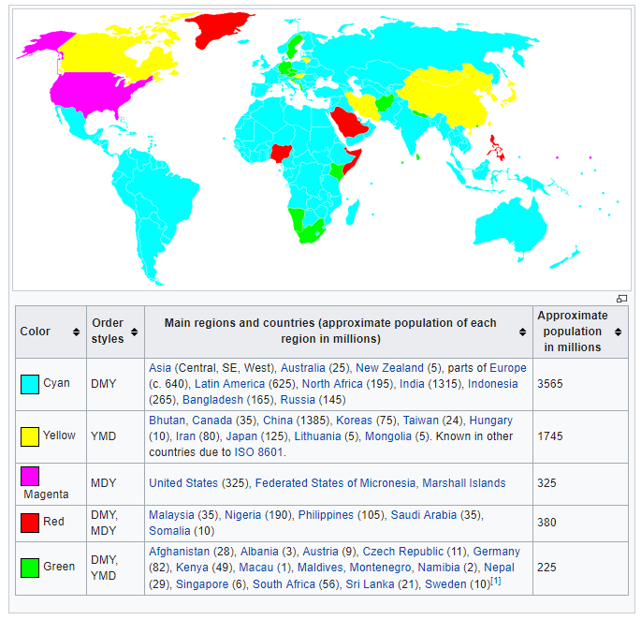
WHAT DOES WRITING THE DATE HAVE TO DO WITH CULTURE?

Slide 9
HOW DO YOU FIND OUT YOUR AGE IN KOREA?
In Korea, everyone is 1 from the time they are born. And everyone gets a year older on New Year's day. So your Korean age is always either one or two years older than your Western age.
Word problem: If a child is born December 1, 2017, how old will the child be on January 1, 2018?

Slide 10
WHAT IS A GEBURTSTAG?
Language makes a cultural difference.

Slide 11
WHY WOULD SOMEONE ASK FOR ZODIAC OR BLOODTYPE?
Cultural significance:
Many Japanese people believe that each blood type has a certain personality and affinity, so it is common for them to ask someone their blood type or try to guess someone’s blood type by their personality. Furthermore, it is not uncommon for women in their 20s and 30s to even select a prospective husband based on his blood type.

Slide 12
GENERAL PERSONALITY OF PEOPLE WHO HAVE TYPE “A” BLOOD
-- Consider things carefully -- Can understand other people’s feelings easily -- Kind -- Good at hospitality -- Don’t express themselves in order to avoid possible quarrel -- Do things carefully and steadily, and don’t take the next step if they are not satisfied -- Honor student types who don’t go off the rail -- Fastidious -- Big on cleanliness -- Can be calm even when accidents happen -- Strong on taking responsibility -- Hard workers -- Safe drivers
Type A blood people’s affinity with each blood type
Partner who is type A – They have many common points; however, both of them are highly strung, so they may be irritated by each other.
Partner who is type B – Type A person envies type B’s happy-go-lucky personality. However, type A person worries about type B person’s personality.
Partner who is type AB – Type AB person is reliable for type A, someone they can turn to for good advice and help. They can have a stable love relationship.
Partner who is type O – Type O person is protective of type A. However, if type A talks
about every small thing, the relationship won’t be good.

Slide 13
WHAT DOES ASKING YOUR OCCUPATION HAVE TO DO WITH CUTLURE?
Cultural significance: In the US, one of the first questions is: What do you do?

Slide 14
WHAT DID YOU GIVE FOR YOUR SUPERVISOR’S NAME?
__ First name
__ First and last name
__ Title and last name

